Slide 1



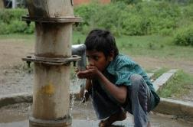

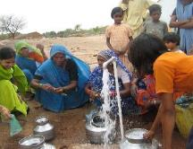

Madhya Pradesh Jal Nigam
Jal Rekha
GIS-based Web & Mobile Application

Slide 2

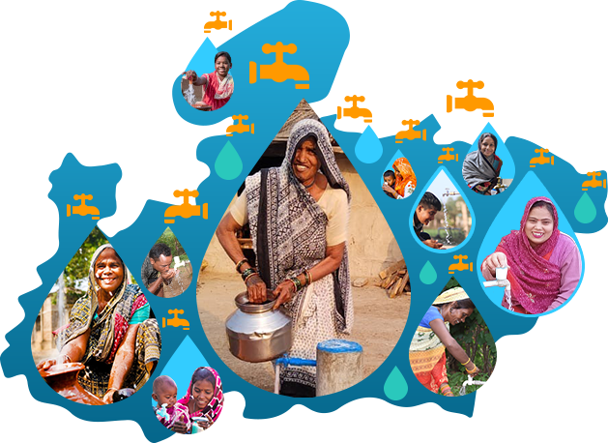


Jal Rekha
GIS-based Web & Mobile Application
2

Slide 3
Jal Rekha – Modules Status
S No | Module | Description | Status
1 | User Role Management | Enables role-based access control, allowing administrators to define and manage user permissions for modules , monitoring, task assignment, and reporting | Completed
2 | Asset Mapping | Users can map assets/Component Point data (Intake well, OHT, BPT,WTP etc.) across different schemes and capture geo-tagged photographs associated with these components | Completed
3 | Traverse functionality | The Traverse functionality enables users to move through the pipeline like CWGM, CWPM, Distribution Pipe and RWPM. | Completed
4 | Geofencing | All map/traverse data has been geofenced for inspections. | Completed
5 | Anusharvan - RFI (Request for Inspection) | Work Monitoring Module have two module Inspection request (RFI) and Inspection History. | Completed
6 | Anusharvan - Daily Inspection | End to end module for reporting, monitoring, approval and notification | Completed

Slide 4
Jal Rekha – Modules Status
S No | Module | Description | Status
7 | Dhara for Quantity of water | The Dhara Module under the Jal Nigam's scheme ensures continuous monitoring and maintenance of water quality across various regions. | Completed & Updation
8 | Sahbhagita | To monitor the social activities performed by the NGOs | Completed
9 | Nirmal for Quality of water | Ensures water quality in various schemes for safe drinking water. Conducts regular tests to detect contaminants or pollutants. | Completed
10 | Sopan | enables contractors to commit to start and completion dates for OHT construction, allowing the department to monitor progress and ensure timely project delivery. | Completed & Updation
11 | FHTC | The FHTC Parinam module in Jal Rekha captures and analyses household tap connection outcomes for each scheme, enabling PIUs and GMs to track coverage against JJM targets, assess scheme‑wise performance, and support data‑driven decisions on saturation and pending FHTCs. | Completed & Updation
12 | Jal Samadhan | This module allows citizens to report issues related to water leakage, water quality, the regularity of water supply, pressure, and other concerns. | Requirement Gathering
13 | O&M Billing | This module simplifies the water supply billing process for the department by directly fetching quantity data from Dhara and quality data from Nirmal. It enhances efficiency while reducing manual effort. | Requirement Gathering

Slide 5
Jal Rekha – Modules Status
S No | Module | Description | Status
13 | Bharosa Factory Testing | The Bharosa – Factory Testing module in Jal Rekha manages end‑to‑end quality testing of water‑supply components by allowing GMs to assign components and inspectors, capture factory test details through web and mobile apps, upload supporting documents (photos, videos, reports), and review consolidated test results for vendor approval and traceability. | Completed
14 | O&M Billing | This module simplifies the water supply billing process for the department by directly fetching quantity data from Dhara and quality data from Nirmal. It enhances efficiency while reducing manual effort. | UAT
15 | Material Testing | Material testing of components at Mobile and web application | UAT

Slide 6
Digital Project Management - Jal Rekha
“Jal Rekha” is a GIS based tool which can be easily accessible via android & web application to monitor and management of the progress in MVS (Multi Village Water Supply Schemes) under JJM in Madhya Pradesh.
Precise Asset Tracking : Real time location tracking of assets installed and parallel visual comparison with approved designs.
Ingenious Quality Assurance: Reduce time consumption in inspection procedures and improved work quality through categorized inspections.
Advance Decision Making : Weekly publishing of progress in workplan, inspection and water supply details enables the “Jal Rekha” team to take precise decisions in time.
Partnering Up : Partnering the geographically referenced design & drawing data sets with other departments like Urban, Road, Telecom, MPEB, Domestic Gas Supply agencies etc enables them to receive NOC from respective departments and to execute their plan in time with out creating any fuss.

Slide 7

Introduction
Jal Rekha is a comprehensive application developed to facilitate real-time monitoring and management of water supply infrastructure in both the execution and O&M phases. The solution comprises both a GIS-based Mobile App and a Web Application. Jal Nigam is implementing various water supply schemes across Madhya Pradesh to ensure clean and safe drinking water reaches every village. To monitor these schemes efficiently, the department requires a robust GIS-based solution.
Mobile Application
Used for surveying and mapping water supply assets.
Captures pipeline details, photos, videos, and GPS coordinates.
Enables real-time data collection and progress tracking.
Web Application
Centralized platform for monitoring project activities.
Enables task assignment and workflow management.
Provides hierarchical tracking and
reporting.

Slide 8
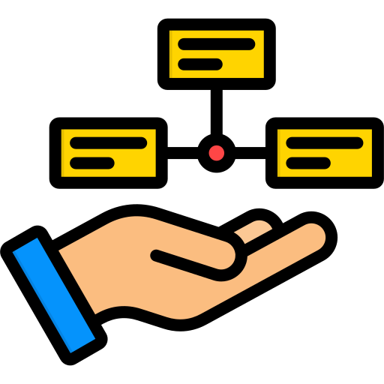
Key Features
Upload drawings of approved planned work as per DPR
Mapping assets across various schemes and capturing geo-tagged photos for effective asset management
Captures contractor commitments for planned start and planned completion dates of different components
Survey of the laid pipeline and other components through the mobile application
Analyzing planned and actual work with easy-to-use visualization tools to enhance monitoring and analysis capabilities
Streamline the submission, tracking, and resolution of RFIs (Request for Information)
Monitoring of water quantity & quality
Enable real-time monitoring of NGO social programs and initiatives.
Integration with SCADA (Supervisory Control and Data Acquisition) and PM Gati Shakti
Enables citizens to access water quality reports and raise grievances to ensure transparency

Slide 9



Current Status
GIS based integrated solution for planning, monitoring and management of Rural water supply schemes (Nal Jal Yojna).
Allows geotagging of assets with traverse functionality to visualize and secure actual vs planned network layouts.
Jal Rekha enables contractors to digitally raise inspection requests, streamlining approvals, ensuring timely verification, and enhancing transparency.
Enables upload of geotagged meter readings for real-time water supply monitoring and data-driven contractor payments.
Planned initiative to empower citizens to report location-based water issues such as leakage, contamination, or waterlogging.
Current Status:
Total Schemes: 147
Total Web Users: 905
Total Mobile Users: 5,255
Total RFIs Raised: 3,70,174
Total Schemes RFIs Generated: 112
Total NGO Activities Recorded: 160,378
Daily Inspections Conducted: 126,740
Total Pipeline Mapped: 135,492 km
Total Assets Surveyed (Intake, WTP, MBR, OHT, IPS, PMBR): 12,286
Total Water Samples Collected: 19205
Daily Water Supply Villages Meter Readings: 3304
Schemes under O&M: 54
Factory Material Tests Conducted: 65
Total functional household tap connection Survey : 29504
MPSSDI, MPSEDC, State IT Center, 47-A, Arera Hills, Bhopal – 462011, URL: www.mpsedc.mp.gov.in

Slide 10
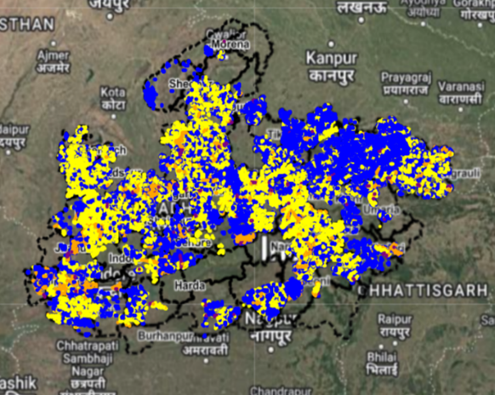
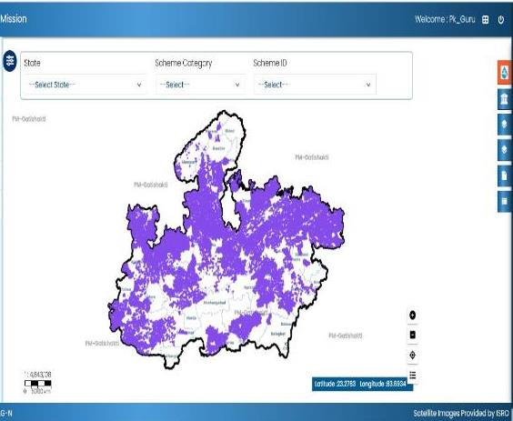
Digital Project Management - Jal Rekha
Information about the MVS assets (Intake Well, WTP, OHT & Supply lines) constructed over the ground are geo-tagged in Jal Rekha application and uploaded on Jal Rekha Portal. These GIS based layers were also successfully uploaded over the PM- Gati Shakti portal through an API.

Slide 11
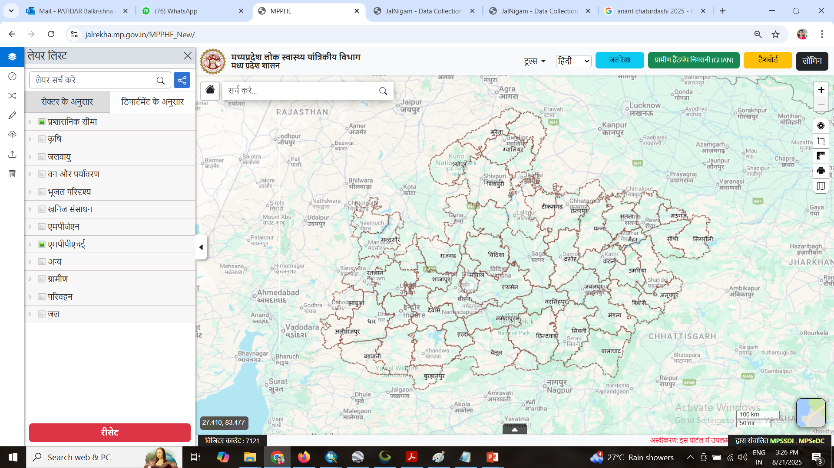
MPPHE Geoportal
https://jalrekha.mp.gov.in/MPPHE_New/

Slide 12
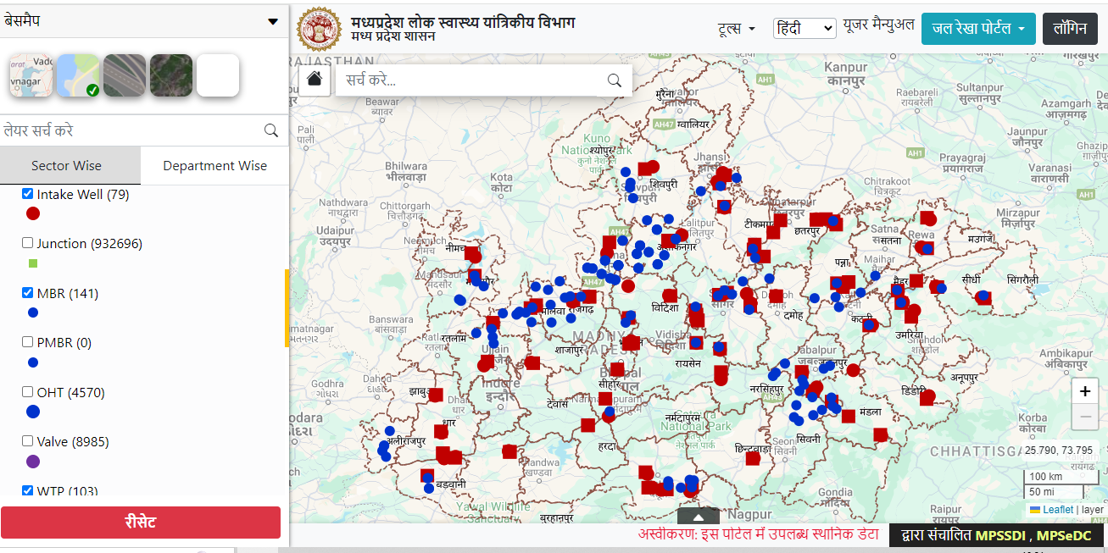
Geoportal

Slide 13
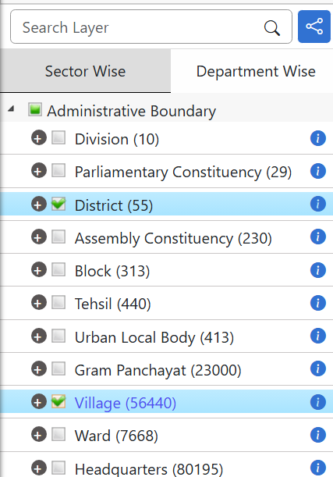
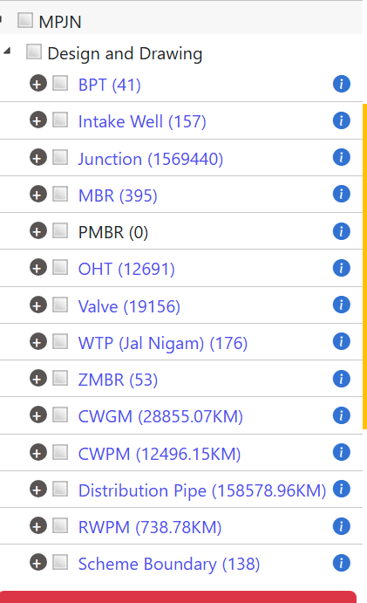
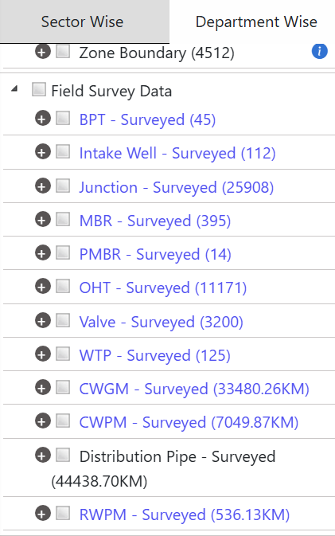

Slide 14
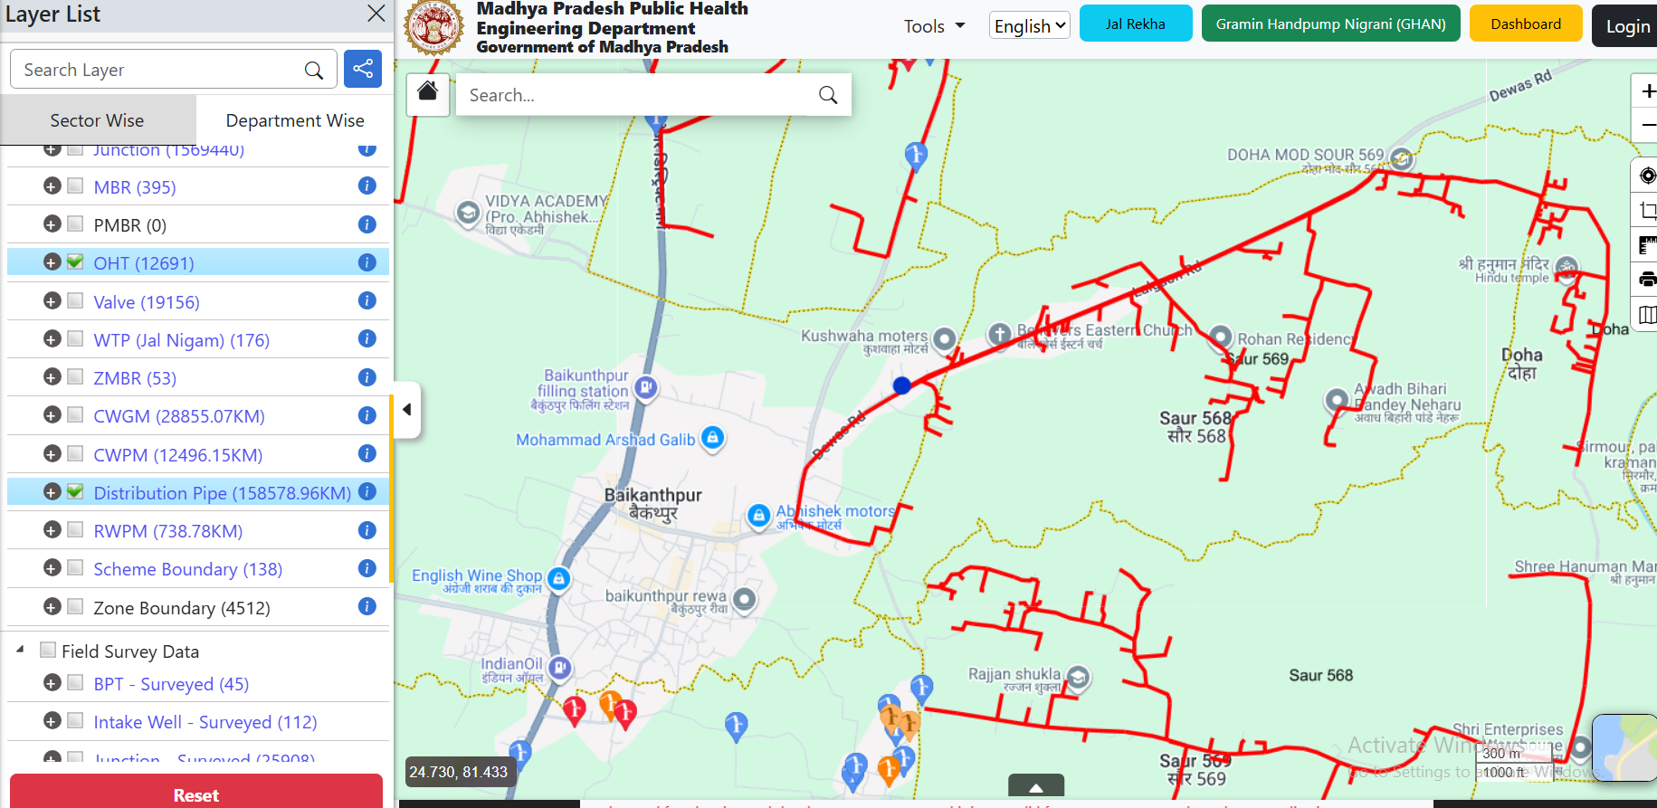
Red line showing Proposed distribution

Slide 15
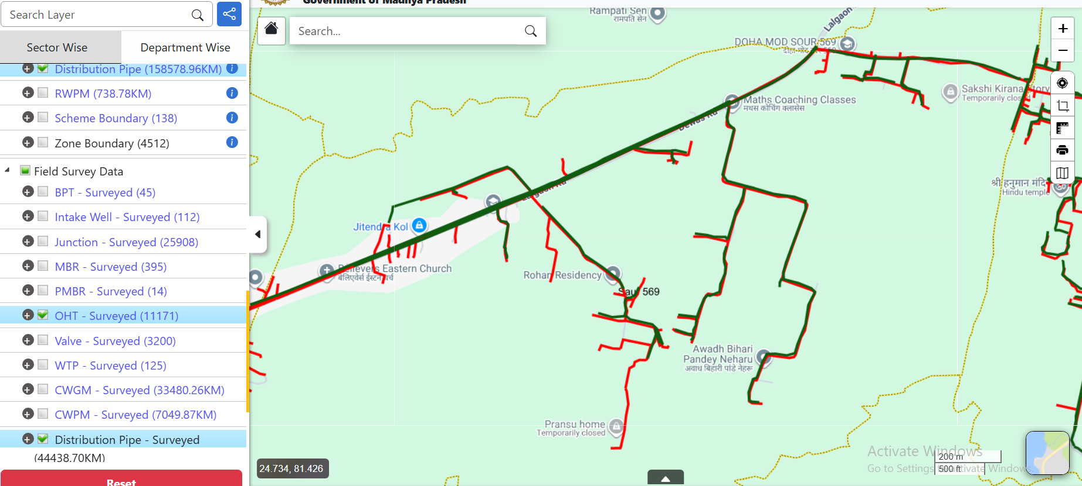
Click on this to layers
on Satellite image
Green line showing Laid Surveyed line (asset mapping using Jal Rekha App)
You can overlay both Proposed & Surveyed line. Click on-off on check box.

Slide 16

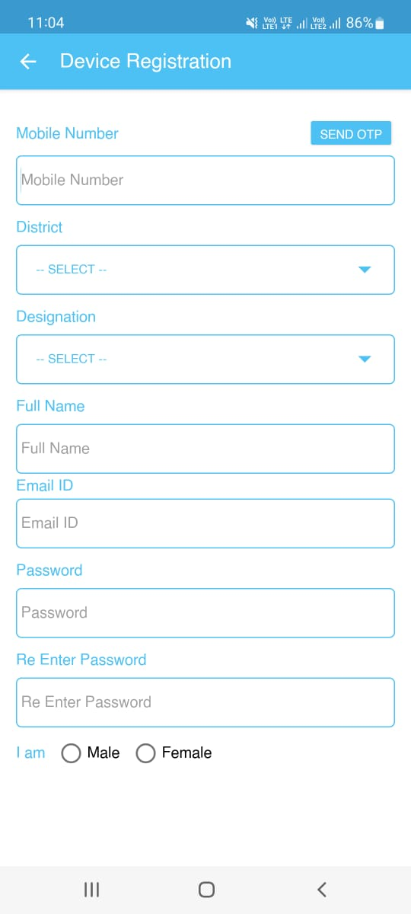
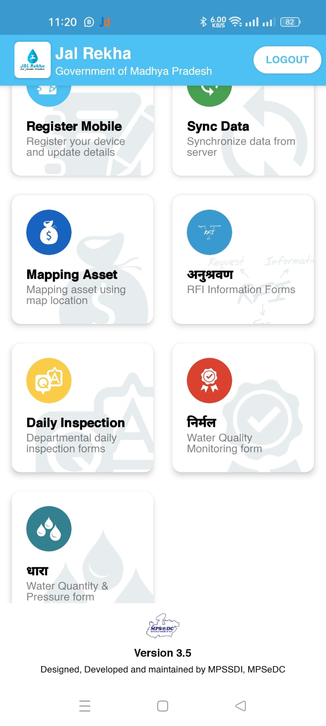
Jal Rekha Mobile Application
Device Registration: Users can register their Android smartphones by completing a registration form within the app. This process allows users to obtain authorization from the administrator.
Sync Data: This feature enables users to synchronize assigned schemes & Components between their device and the server, ensuring that the most up-to-date assigned work is available to the user.
Mapping Asset: Users can map assets across different schemes and capture geo-tagged photographs associated with these components, helping them to effectively manage and track assets.
Geofencing for data updation/ Upload Asset: After mapping assets, users can upload the information to the server, ensuring that the asset data is stored centrally and accessible to authorized users as needed.
16
Mobile App https://play.google.com/store/apps/details?id=mapitgis.jalnigam.release

Slide 17
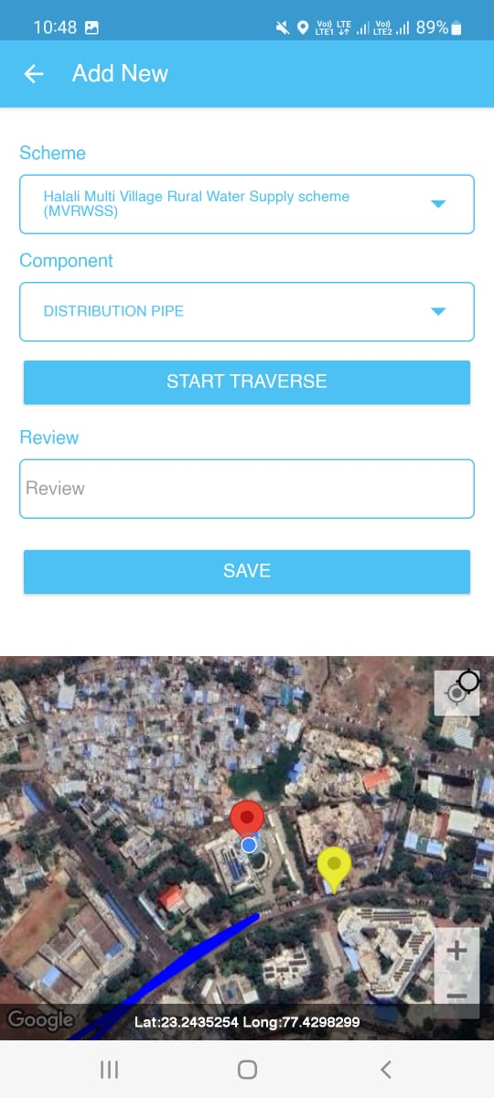
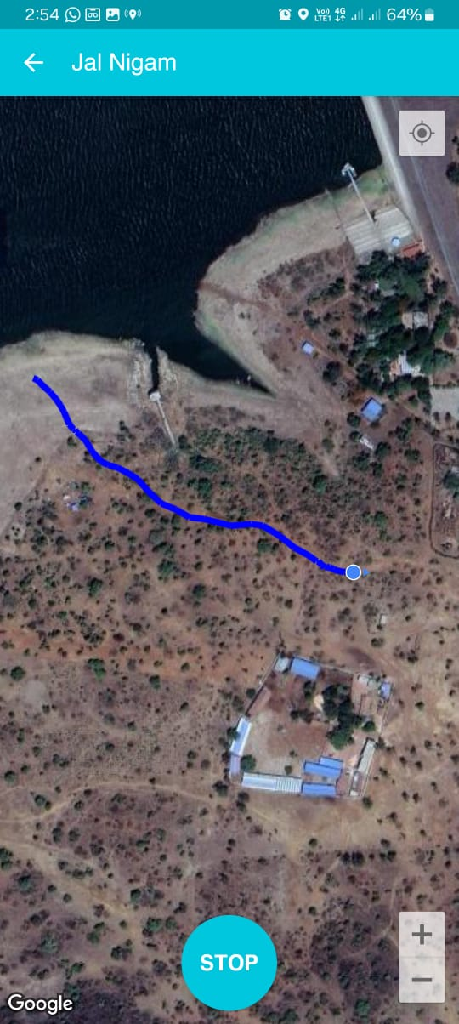
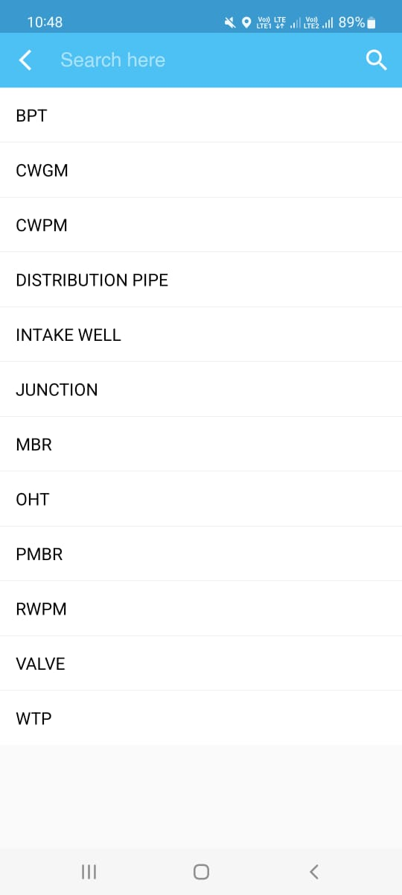
Traverse in Mapping Asset
The Traverse functionality enables users to move through the data and explore different attributes (CWGM, CWPM, Distribution Pipe and RWPM, or spatial locations. The scheme and ESR name fields are pre-filled and assigned by the PIU. Users can select a component from a dropdown menu, click a photo, enter a review, and save the location. The app can access the user's location after registration.
17

Slide 18
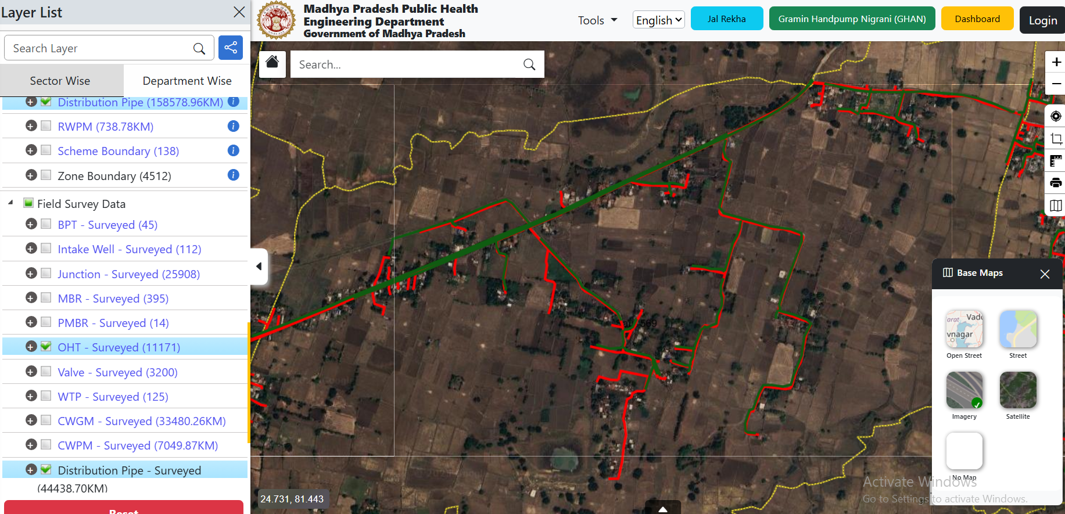

Slide 19
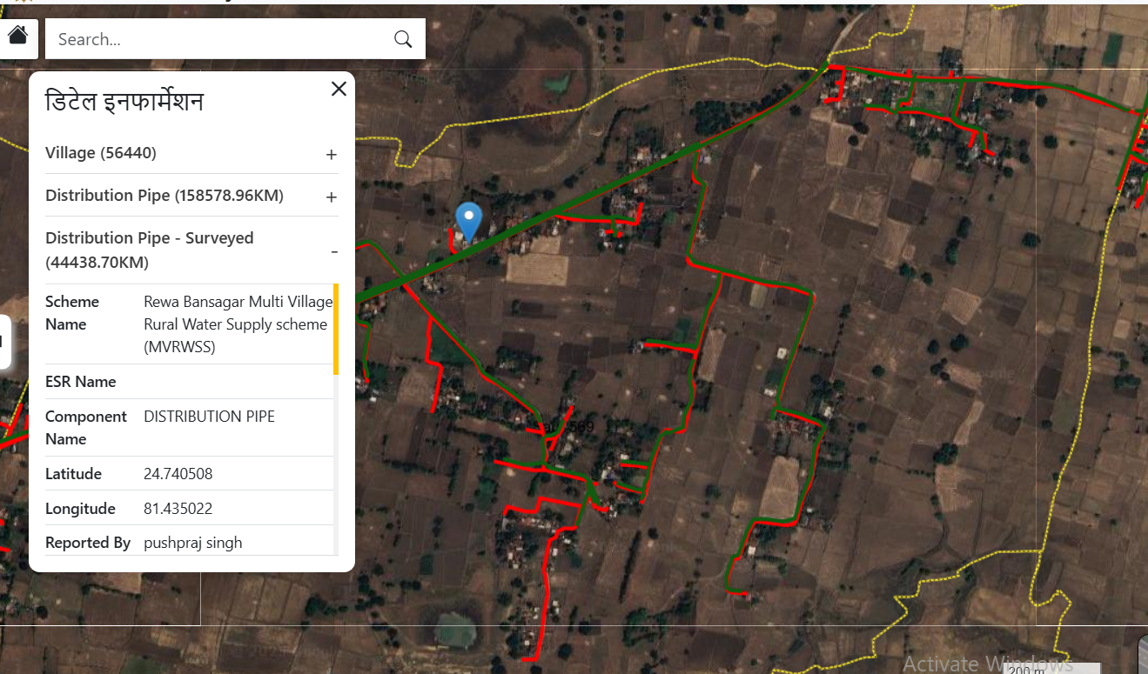
Click on line or point to see attribute detail

Slide 20
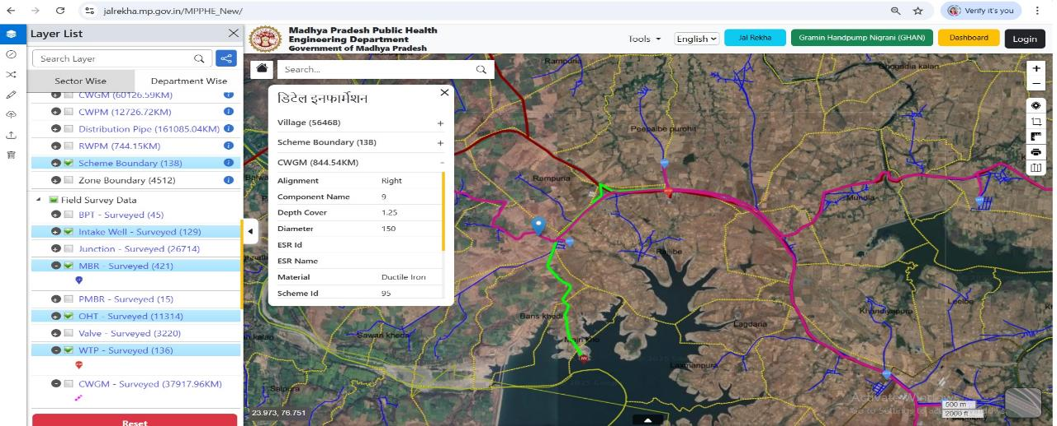
Asset Mapping - Mapping of Pipe Network
Details as on 24.11.25
Planned Length (km) | Uploaded Length (km) | % Progress | Pipeline laid (km) | Surveyed length (km) | % Surveying Progress wrt Laying
2,16,754 | 2,06,234 | 95% | 1,50,286 | 1,24,347 | 83%

Slide 21
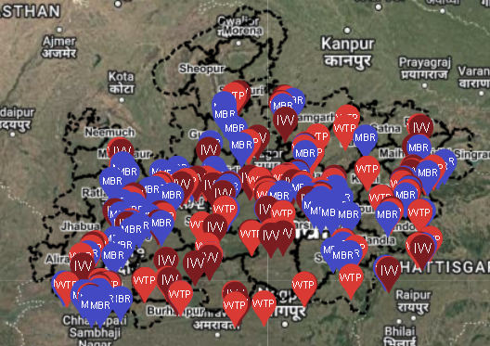
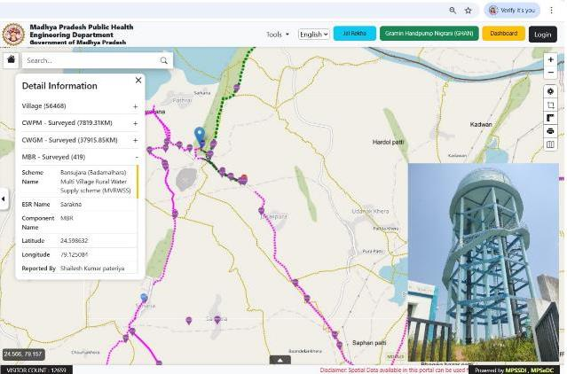



Details as on 24.11.25
Asset Mapping – Mapping of Point data (OHT, MBR, WTP, Intake)
Total Points | Uploaded | % Progress | Executed Qty | Surveyed | % Surveying Progress wrt Execution
12,428 | 11,448 | 92s% | 12,772 | 12,220 | 95%
Legend
 | Intake Well |  | WTP |  | MBR

Slide 22
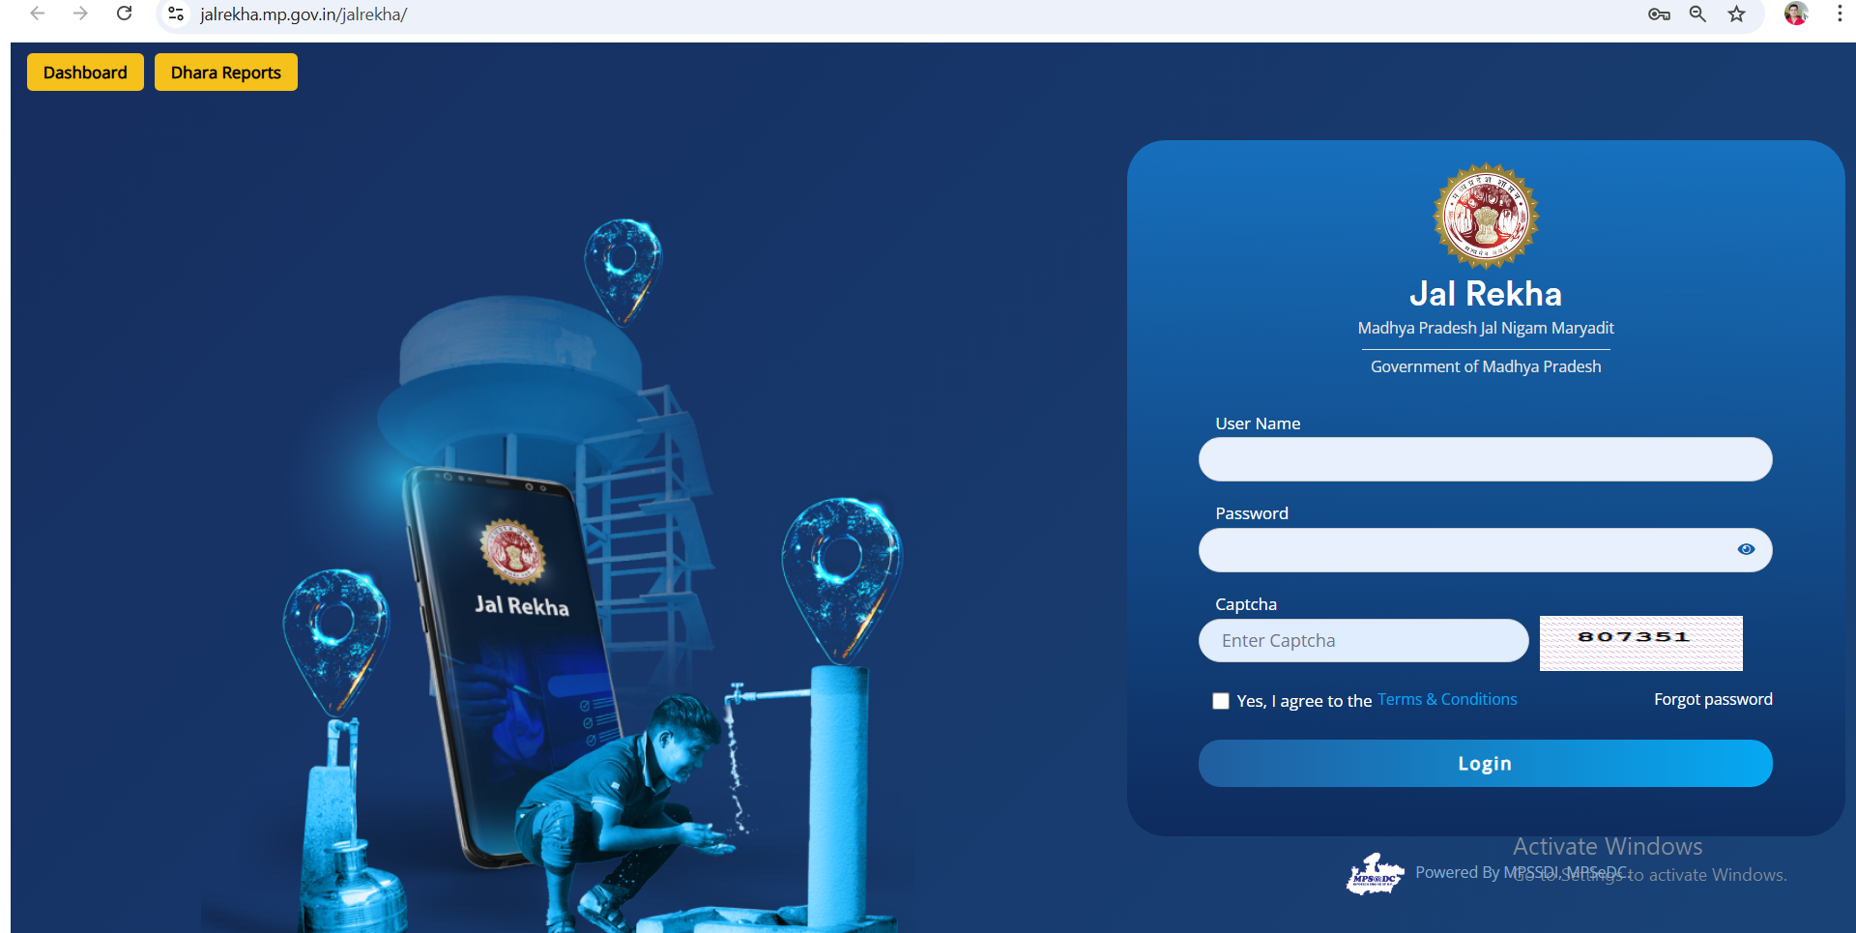
Jal Rekha Portal
https://jalrekha.mp.gov.in/jalrekha/

Slide 23
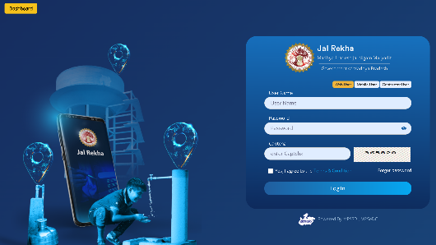
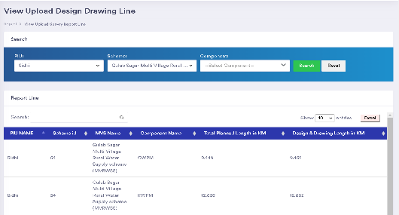
Asset Mapping & Management (GIS-based Modules)
Design and Drawing: All approved components of the schemes viz. Intake Well, WTP, Pipelines, and OHTs are being mapped to the GIS-based portal of Jal Rekha.
Field Survey Data: The geotagged location and photo of the component are being uploaded on the mobile app by the field officers, which shows the actual location of the component.
Data Visualization: Visualize approved design & drawing and updated as-built data on the map.

Slide 24
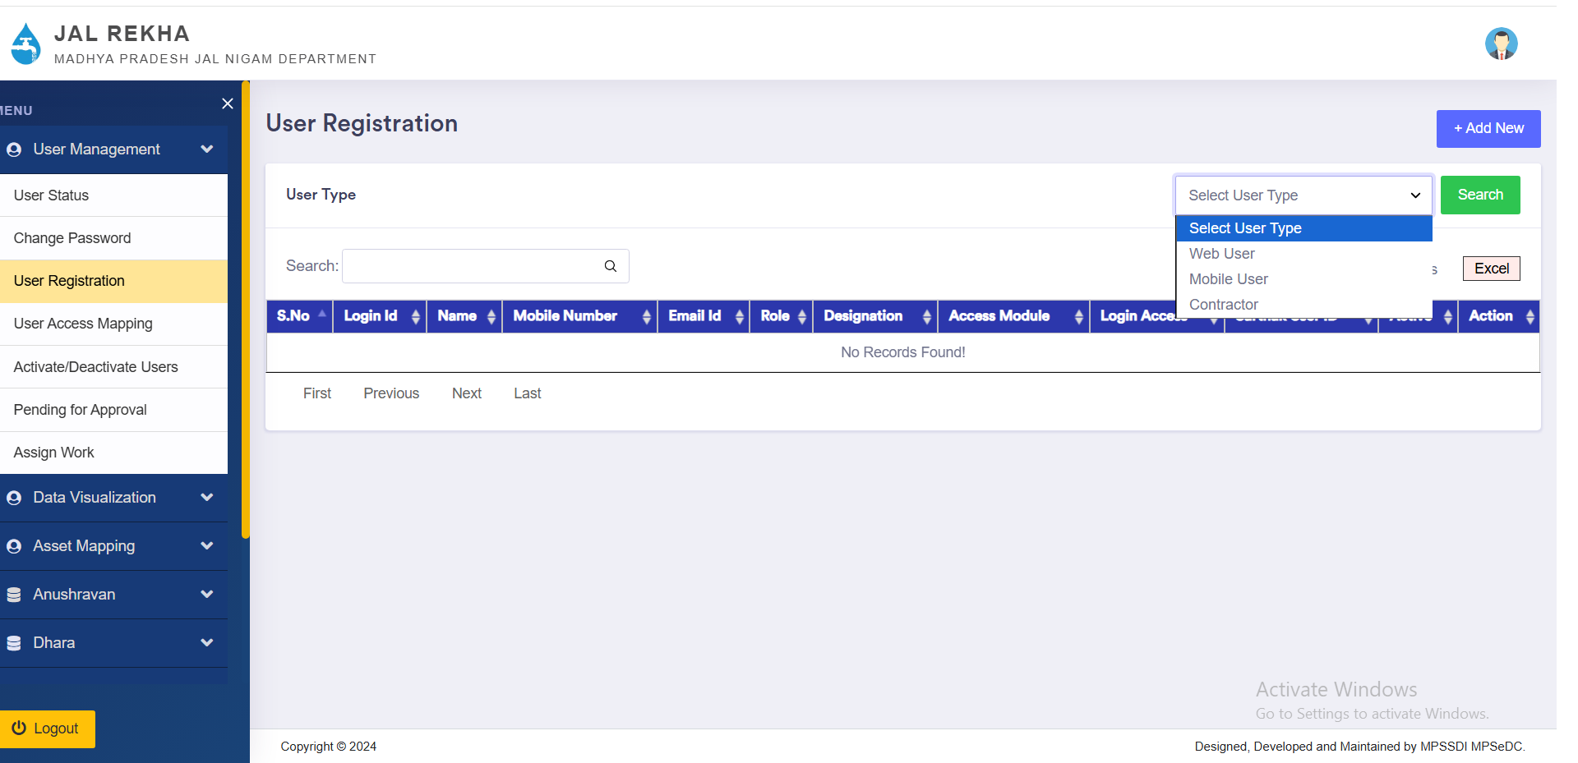
User Management

Slide 25
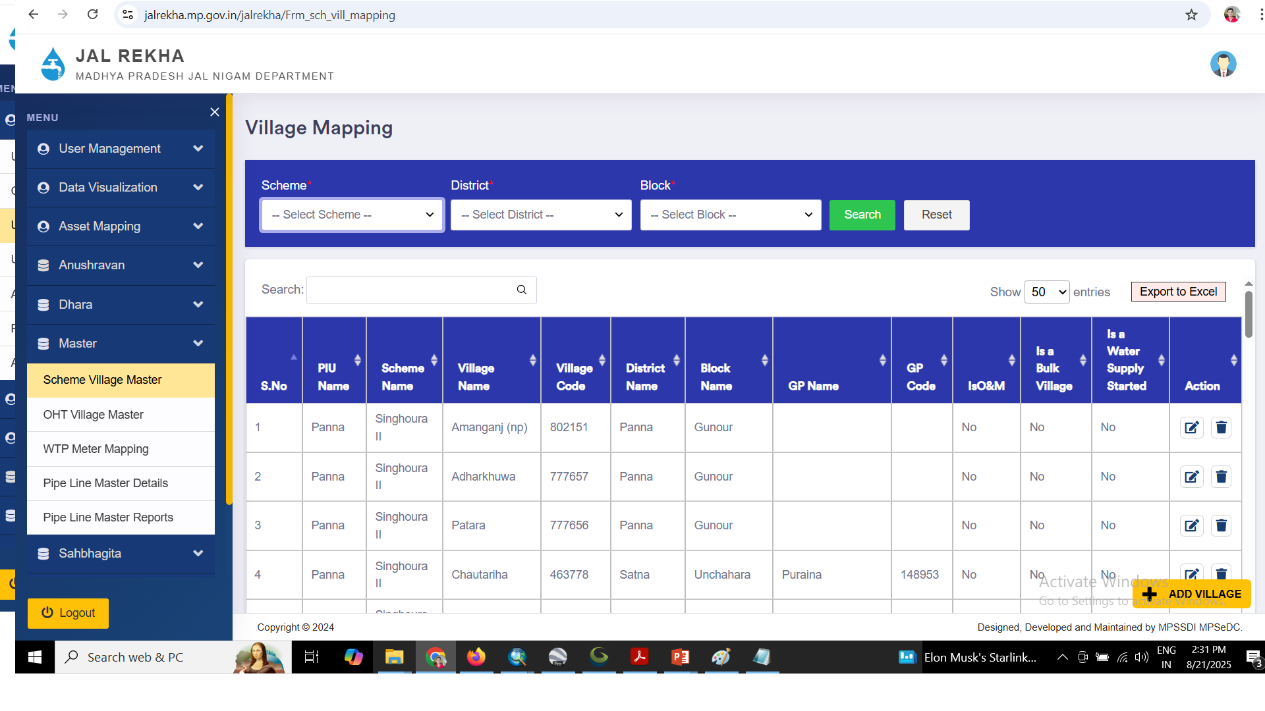
Scheme Village Master

Slide 26
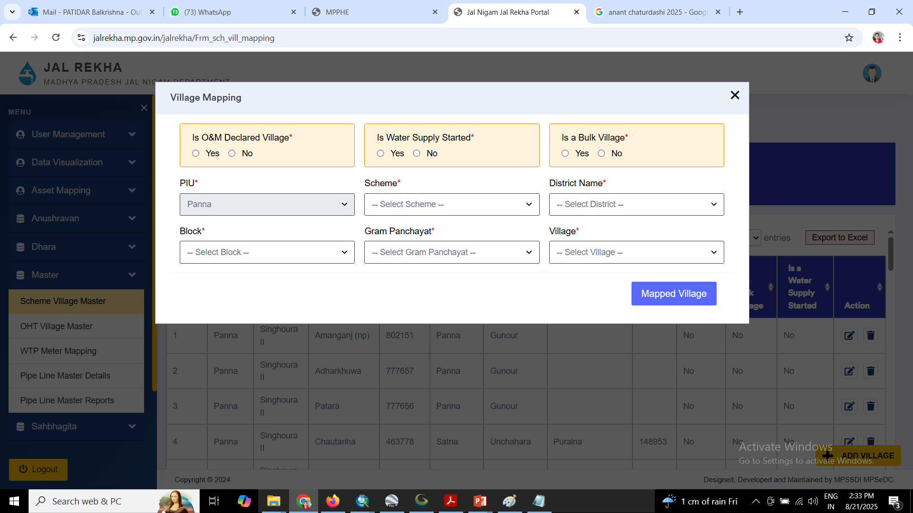

Slide 27
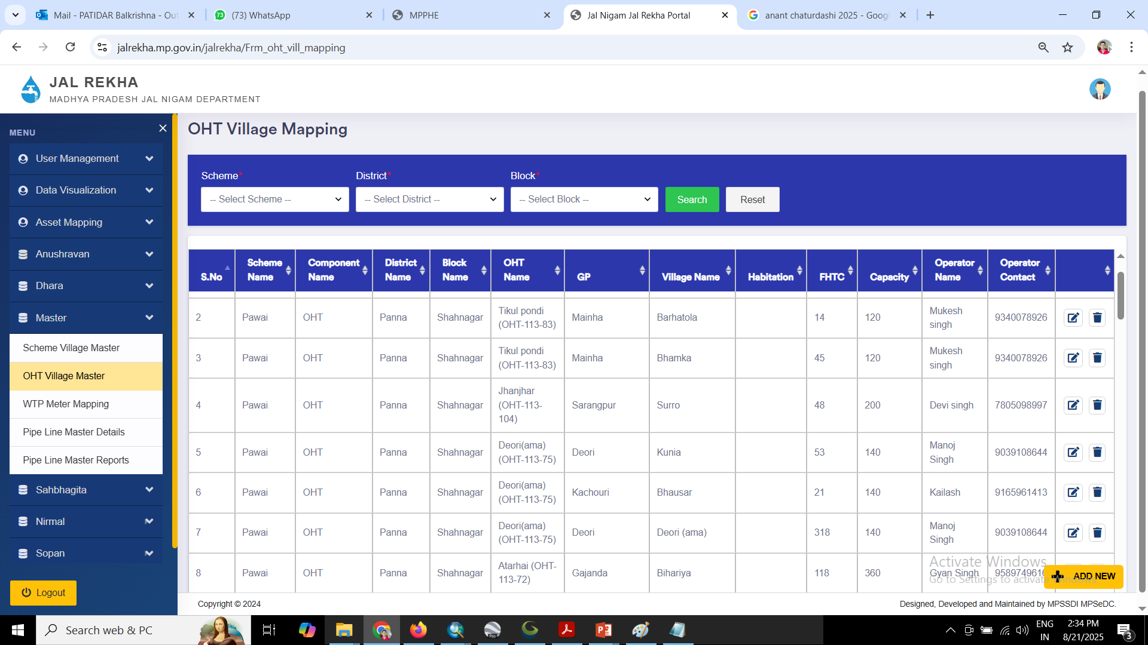
OHT Village Master

Slide 28
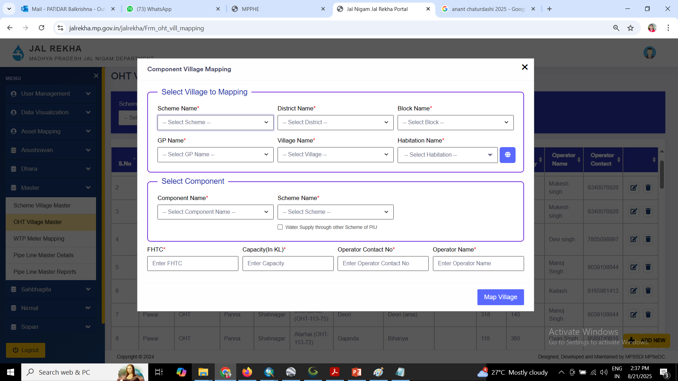

Slide 29
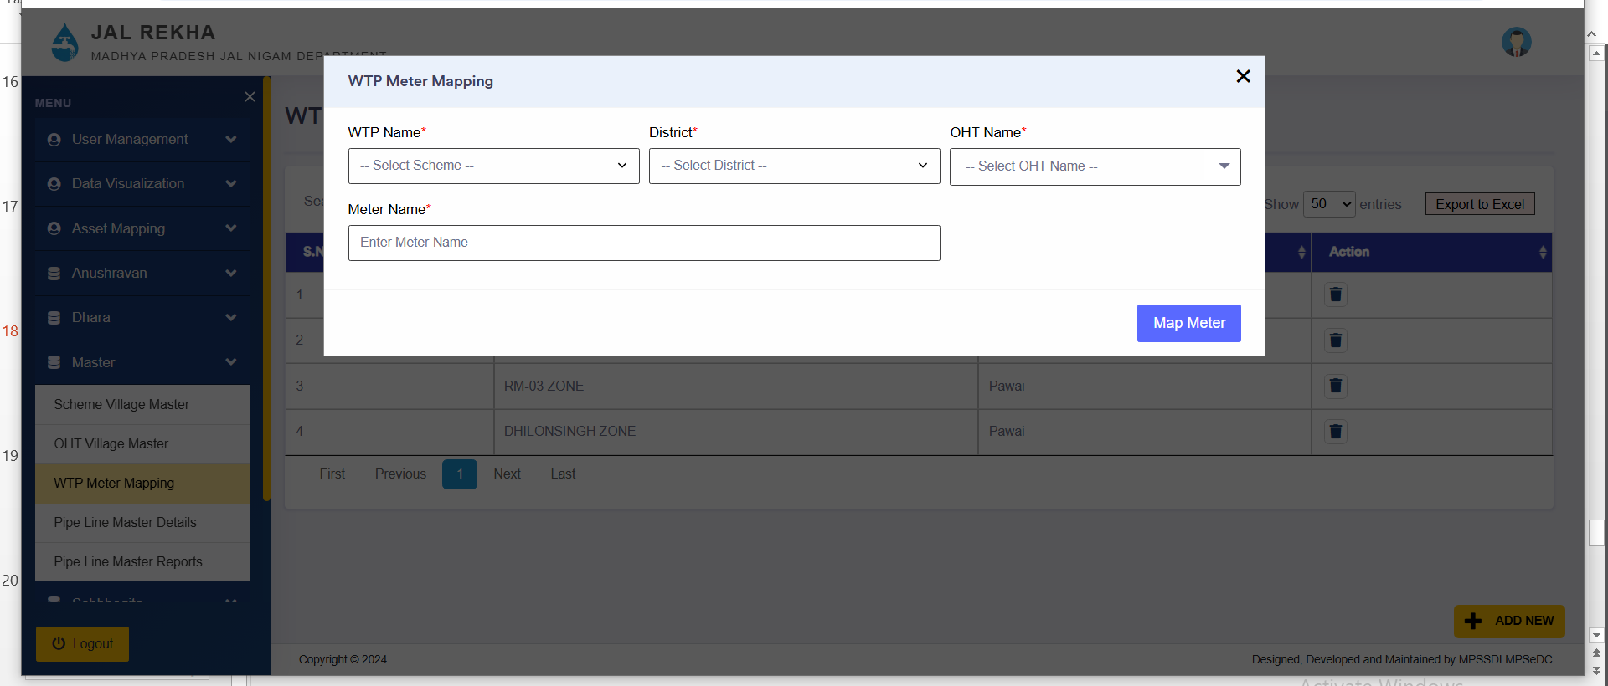
WTP Meter Mapping

Slide 30
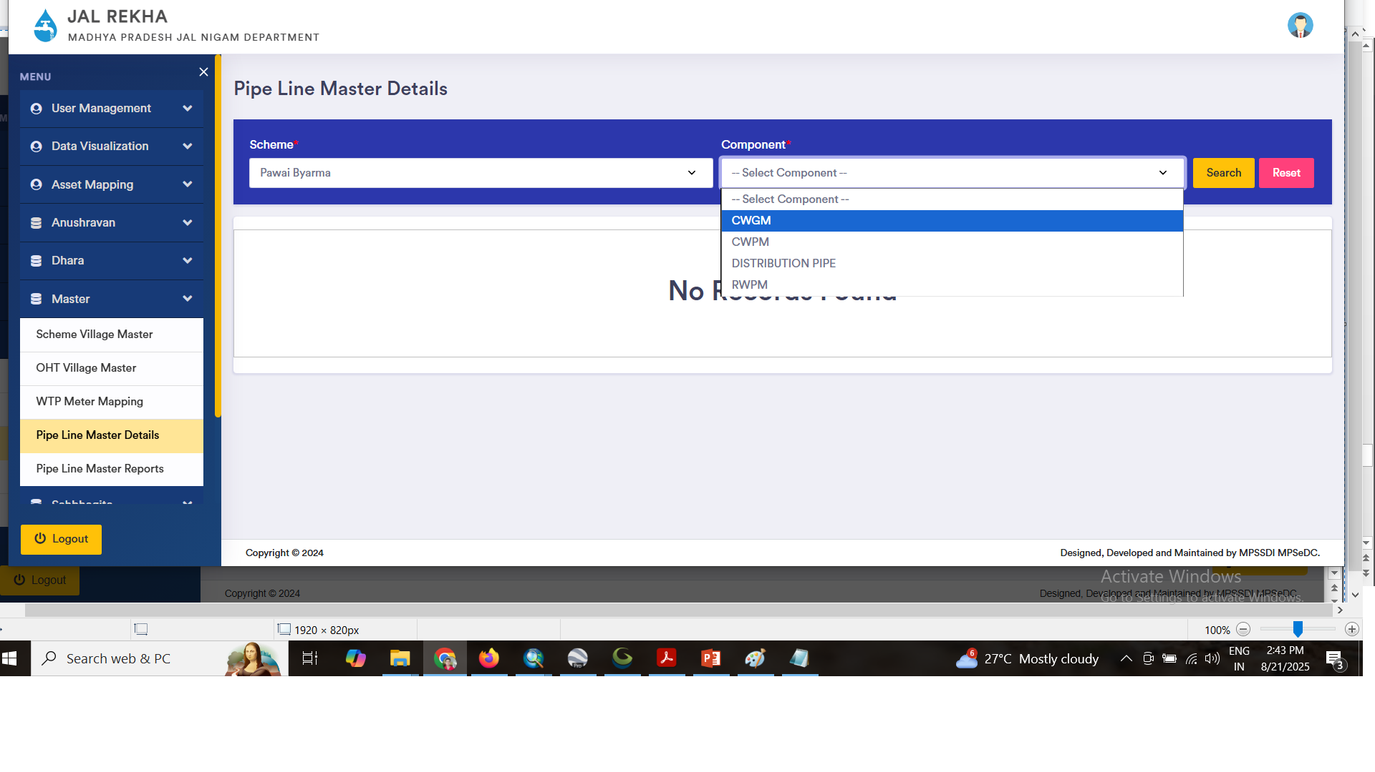
Pipe Line Master

Slide 31
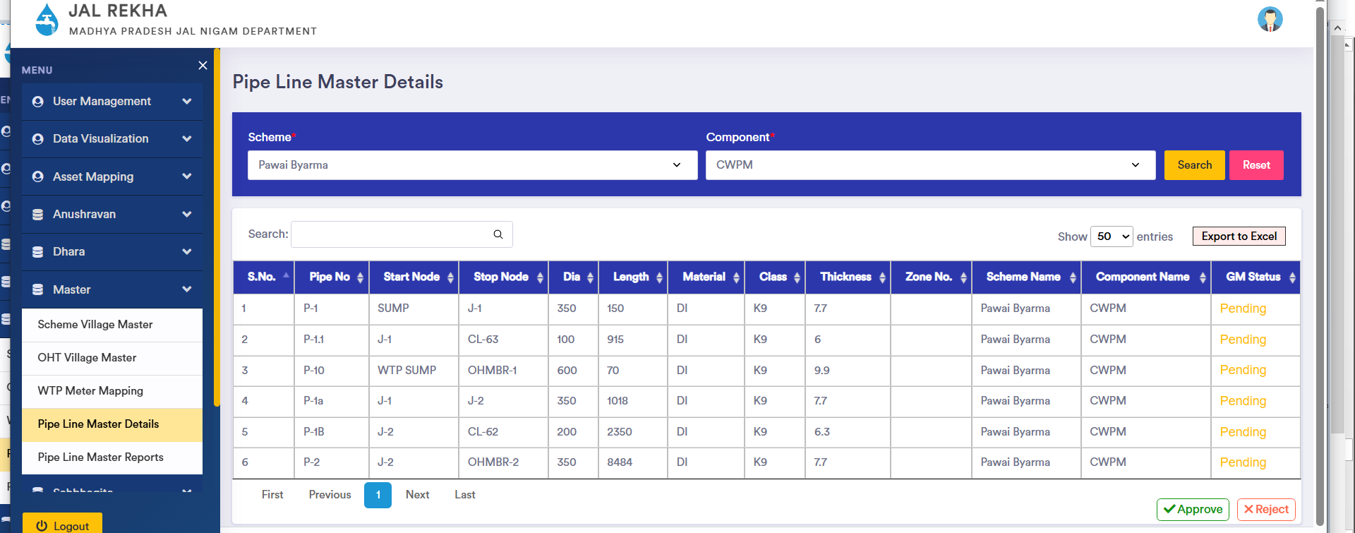

Slide 32
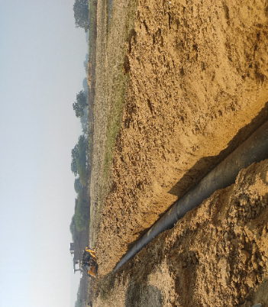
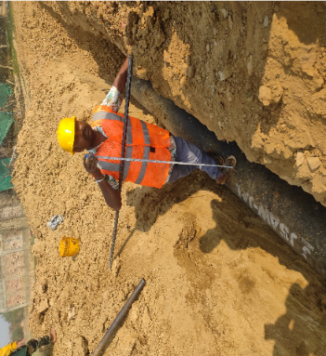
Jal Rekha – RFI
Depth and Alignment checking
Component: CWGM
MVS Name: Tamas MVS
Inspection Date : 30-01-2025
Status : Accepted

Slide 33
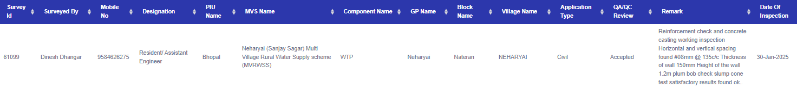
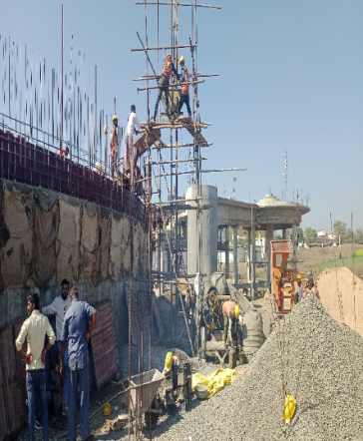
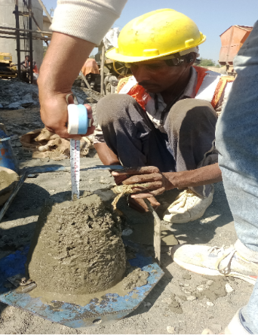
Jal Rekha – RFI
Checking of reinforcement and concrete casting work, vertical spacing, Height of the wall and plum bob check with slump cone test
Component: WTP
MVS Name: Sanjay Sagar (Nehrayi) MVS
Inspection Date : 30-01-2025
Status : Accepted

Slide 34
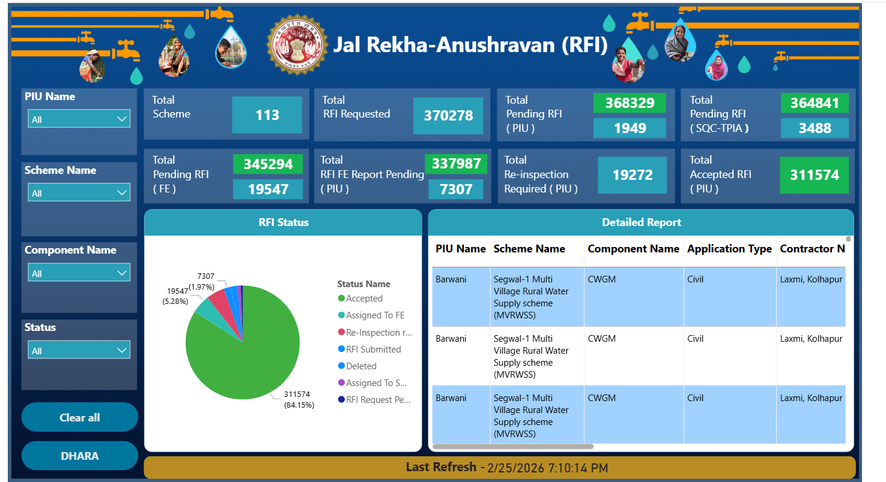
Anushravan Module for “Request for Inspection” for execution monitoring
RFI (Request for Inspection): RFI (Request for Inspection) is submitted by contractors through this application. The RFIs will be assigned by CGMs / GM, PIUs to SQC or TPIA personnel.
Daily Inspection: MPJN officials / Consultants can submit the observations during site visit including geotagged photographs. Contractors needs to address the observations.

Slide 35

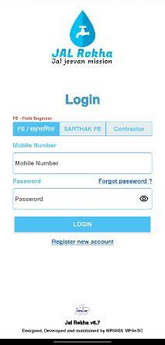
Sahbhagita Module – ISA Activities Monitoring
Sahbhagita Module tracks the activities performed by the Implementation and Support Agencies (ISAs) for awareness generation and information dissemination.
Key Benefits:
Enhanced Monitoring & Supervision
Improved Data Management
Transparency & Accountability
User-Friendly Interface & Accessibility
Strengthening Community Participation

Slide 36
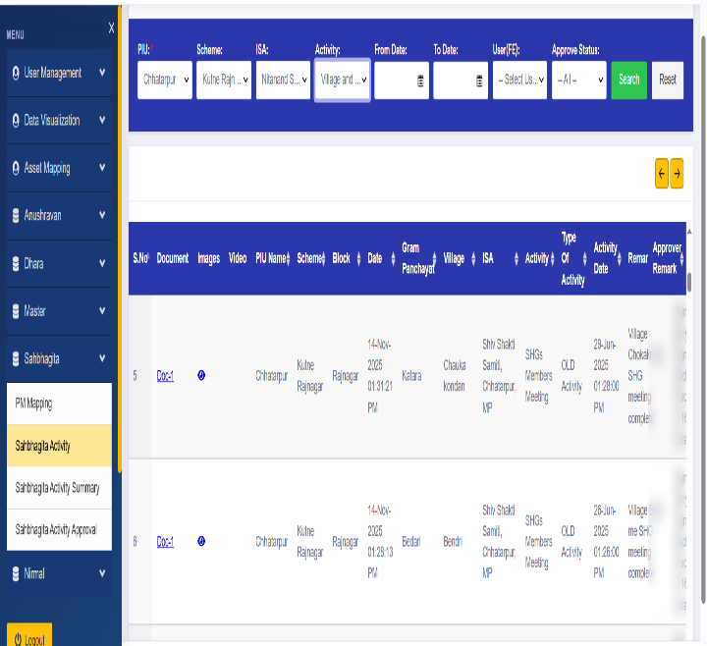
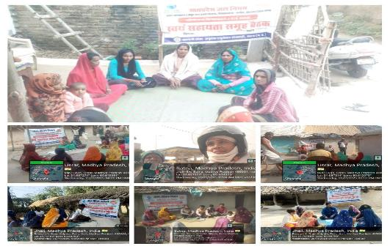
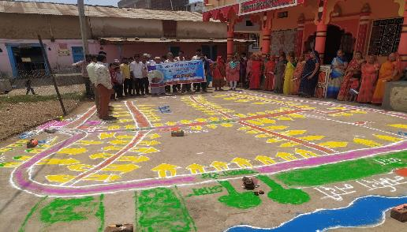
Sahbhagita Module – ISA Activities Monitoring

Slide 37
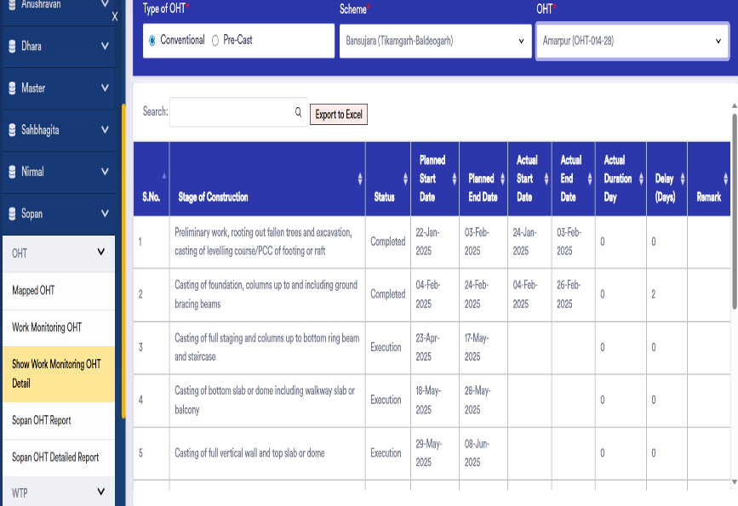
Sopan Module – Construction Work Progress Monitoring of Structures (WTP, OHT etc)
Sopan Module tracks the stage wise activities performed at the time of implementation of Over Head Tanks.
Key Benefits:
Help in track the actual stage of work completed
Track the delays in Stage wise development
Track the financial liabilities procured at site

Slide 38
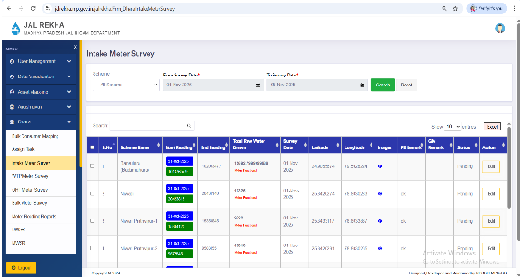
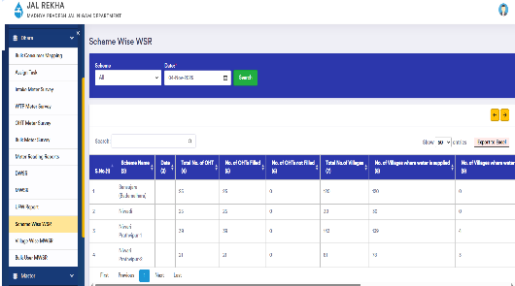
Dhara Module – Water Supply Quantity Monitoring
Dhara module is a crucial component for maintaining and monitoring detailed volumetric data for all water supply schemes.
Daily Water Supply Report (DWSR) is the crucial output from this module on a daily basis.
Collected data is then utilized in the Panchayat Darpan Portal to generate and issue bulk water charges bills to the GPs.
Ensures accurate billing and transparent access to overall water usage information for the contractors as well as users (Gram Panchayats)

Slide 39
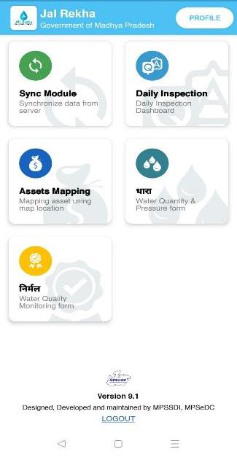
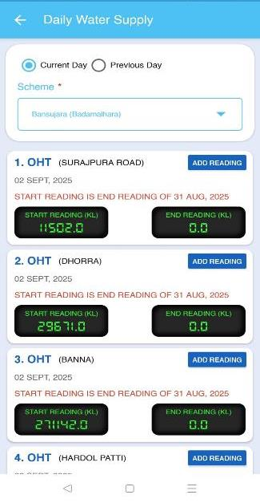
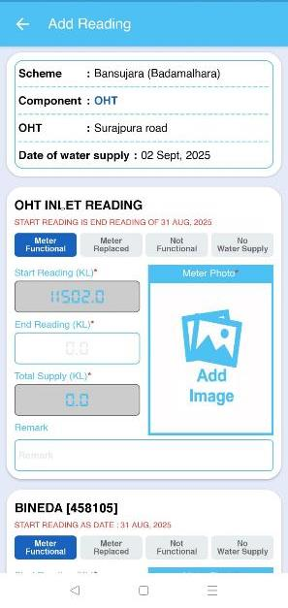

Dhara Module – Water Supply Quantity Monitoring

Slide 40


Dhara Module – Water Supply Quantity Monitoring

Slide 41

Dhara Module – Water Supply Quantity Monitoring

Slide 42

Sopan Module
Sopan Module tracks the stage wise activities performed at the time of implementation of Over Head Tanks.
Key Benefits:
Help in track the actual stage of work completed
Track the delays in Stage wise development
Track the financial liabilities procured at site

Slide 43
Sopan Module
Components
OHT
WTP
Intake well
IPS

Slide 44

Sopan Module – Mapped OHTs with Scheme

Slide 45

Sopan Module – Mapped OHTs with Scheme

Slide 46

Sopan Module – Details to be Entered

Slide 47


Nirmal Module – Water Quality Monitoring
Nirmal: Nirmal module is developed to assess and monitor the quality of water supplied by the schemes, to ensure that the water supplied meets various quality standards. Regular testing ensures drinking water supply as per BIS:10500 in the planning area.

Slide 48




Nirmal Module – Water Quality Monitoring

Slide 49


Nirmal Module – Water Quality Monitoring
Clear water Sample at WTP
&
Raw Water Sample at Inlet WTP

Slide 50


Nirmal Module – Water Quality Monitoring
Sample at OHT
&
Beneficiary at Village

Slide 51



Nirmal Module – Water Quality Monitoring

Slide 52

Nirmal Module – Water Quality Monitoring

Slide 53
Bharosa – Pre-dispatch material inspection by TPIA
“Bharosa” :
QAPs: Uploading approved Quality Assurance Plans (QAPs) for all material to be procured.
Material Testing Record Keeping: The module facilitates recording comprehensive pre-dispatch material testing details to ensure quality and compliance with standards.
Real-Time Updates: Provides real-time notifications and updates on testing results, enhancing transparency and decision-making.
Streamlined Process: Integrates seamlessly with existing workflows, improving efficiency in the material dispatch process and reducing delays.

Slide 54






जल जीवन मिशन के जतन का फल।
घर-घर पहुँचे निर्मल जल।।

